Slide 1

~ Presentation ~ SDLC (Software Development Life Cycle)
Hello!
In this presentation, you know the difference between Waterfall, Agile, Spiral, and V-Model software development. For each method, you learn what happens at each stage, the pros and cons, and finally, which method is better.
Let's start!
But first, a little about each model ...

Slide 2

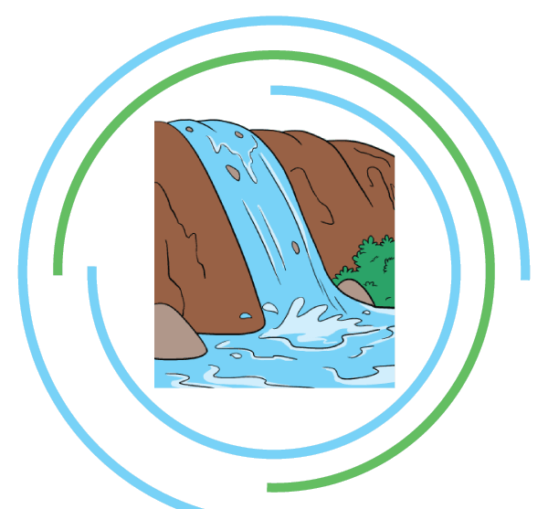
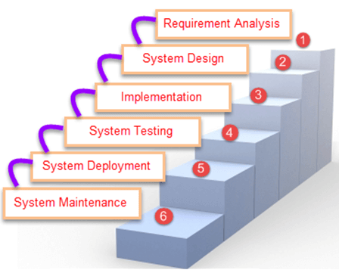
~ Waterfall ~
- The waterfall was the first model that was presented. This is a software development life cycle (SDLC).
- It is also known as a linear sequential model of the life cycle, because it illustrates the process of smooth transformation in the lower reaches, simulating the flow of analysis.
- Typically, the result of one phase acts as an input for the next stage.

Slide 3
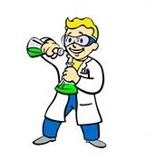
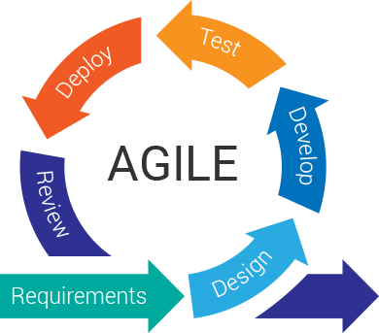
~ Agile ~
- Agile, this is the basis of the software development process, requirements, design, develop, test, deploy, review.
- A typical agile model of a non-terminating cycle.

Slide 4
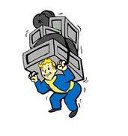
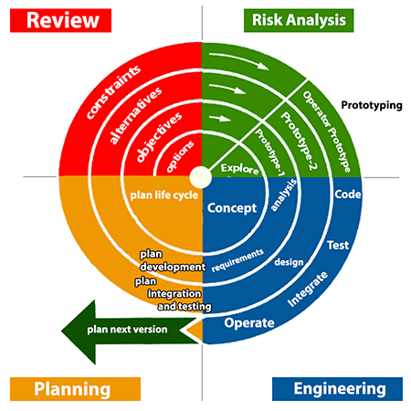
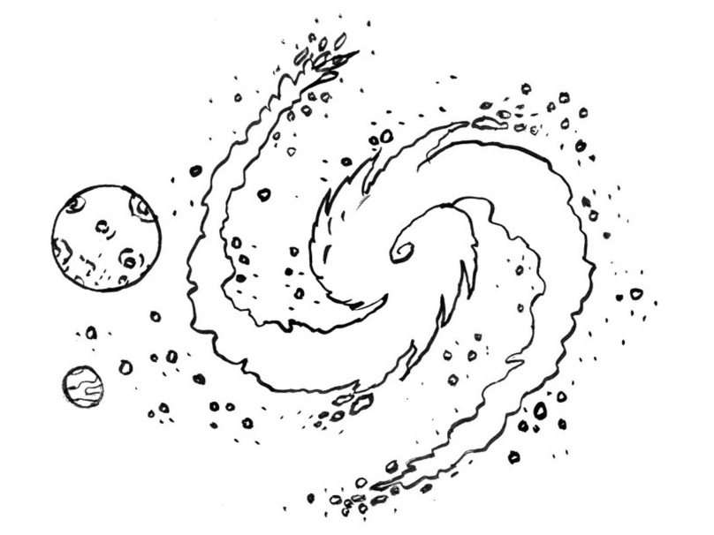
~ Spiral ~
- A spiral model similar to agile. It consists of four stages: planning, risk analysis, engineering, and review.
- A distinctive feature of this model is a special attention to the risks affecting the organization of the life cycle.

Slide 5
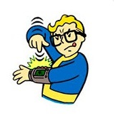
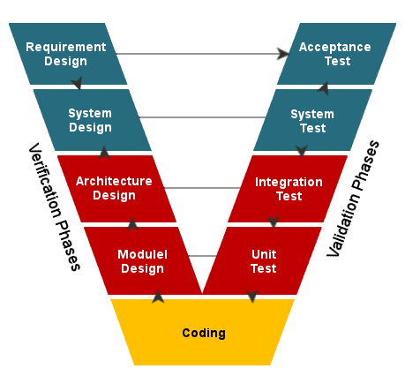
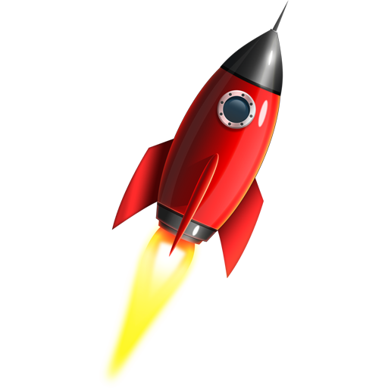
~ V-Model ~
- V-model is a set of steps that lead to each other. Testing is more emphasized in this model than in the Waterfall model.
- Testing procedures are developed at the beginning of the procedure, before any coding is performed.

Slide 6
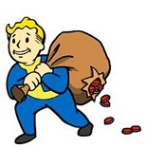
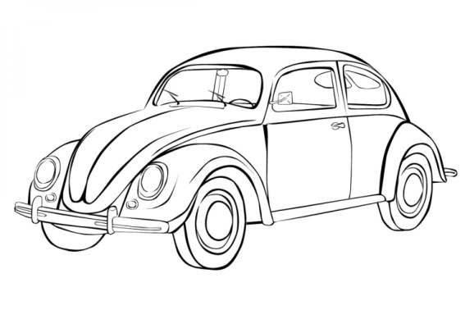
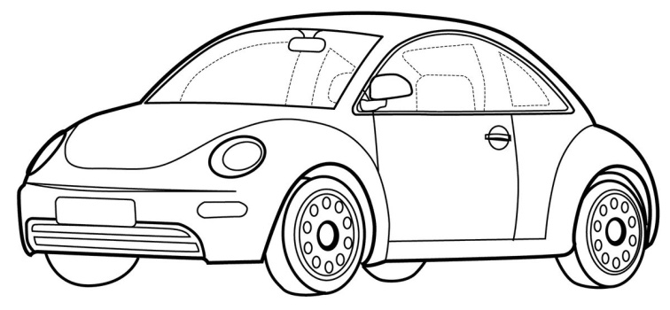
~ Waterfall ~ Pros and cons of the cascade model:
+ Full documentation of each stage;
+ Clear planning of terms and costs;
+ Transparency of processes for the customer;
- The need to approve the full scope of system requirements at the first stage;
- If it is necessary to make changes to the requirements later, return to the first stage and redo all the work done;
- Increasing the cost of funds and time in case of need to change the requirements.
Despite the fact that the cascade model is still in use, it has already lost its former positions. Today, it is being replaced by more advanced software development models and methodologies.
When to use cascade model:
- In projects with clearly defined requirements for which no changes are foreseen in the development process;
- For projects that migrate from one platform to another. That is, the requirements remain the same, only the system environment and / or programming language changes;
- When a development company is not required to carry out testing - for example, the customer or a third-party company will provide it with security.

Slide 7
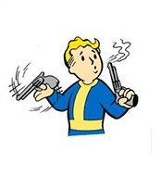


~ Agile ~ Pros and cons of the iterative model:
+ Early creation of working software;
+ Flexibility - willingness to change requirements at any stage of development;
+ Each iteration is a small stage for which testing and risk analysis is easier to provide than for the entire product life cycle.
- Each phase is independent, separate iterations are not imposed;
- Problems may arise with the implementation of the overall system architecture, since not all requirements are known at the beginning of the design.
When to use an iterative model:
- For large projects;
- When at least the key requirements are known;
- When project requirements may change during the development process.
The iterative model is a key element of the so-called “flexible” (Agile)
Samsung Fold - large and flexible project…

Slide 8



~ Spiral ~ Pros and cons of the spiral model:
+ Improved risk analysis;
+ Good documentation of the development process;
+ Flexibility - the ability to make changes and add new functionality even at relatively late stages;
+ Early creation of working prototypes.
- Can be quite expensive to use;
- Risk management requires the involvement of highly qualified specialists;
- The success of the process largely depends on the stage of risk analysis;
- Not suitable for small projects.
When to use the spiral model:
When risk and cost analysis is important;
Large long-term projects with no clear requirements or the likelihood of their dynamic change;
- When developing a new product line.

Slide 9
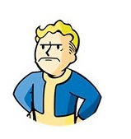

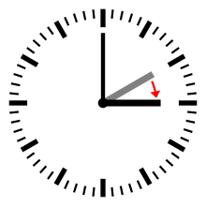
~ V-Model ~ Pros and cons of the V-model:
+ Strict phasing;
+ Planning of testing and verification of the system are carried out at the early stages;
+ Improved, compared to the cascade model, time management;
+ Intermediate testing.
- Insufficient flexibility of the model;
- The actual creation of the program occurs at the stage of writing the code, that is, already in the middle of the development process;
- Insufficient risk analysis;
- There is no work with parallel events and the possibility of dynamic changes.
When to use V-model:
- In projects in which there are temporary and financial constraints;
- For tasks that involve a wider, compared to the cascade model, test coverage.

Slide 10
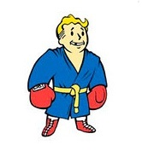
And so my friend now you know all the pros and cons of SDLC (Software Development Life Cycle) I wish you a good swimming!
And yes, click on the "save" button more often…

